Slide 1

POWER BI
NGOC DIEP

Slide 2
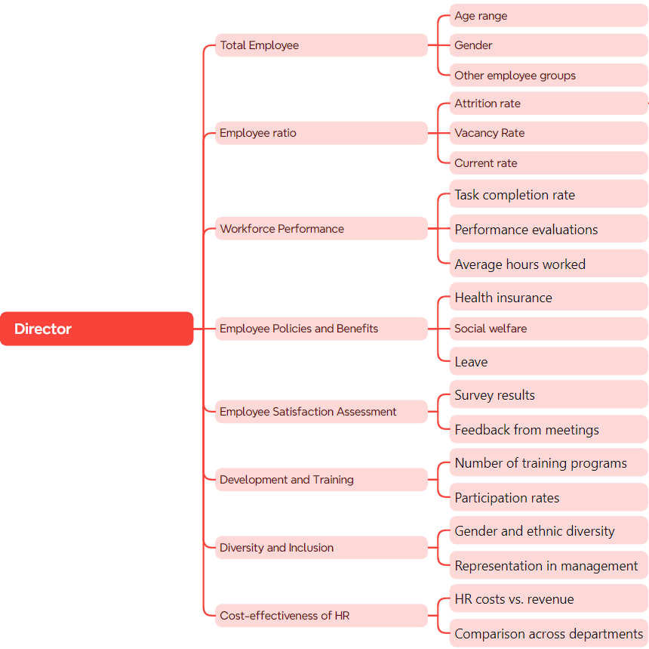
Director's Mind map

Slide 3
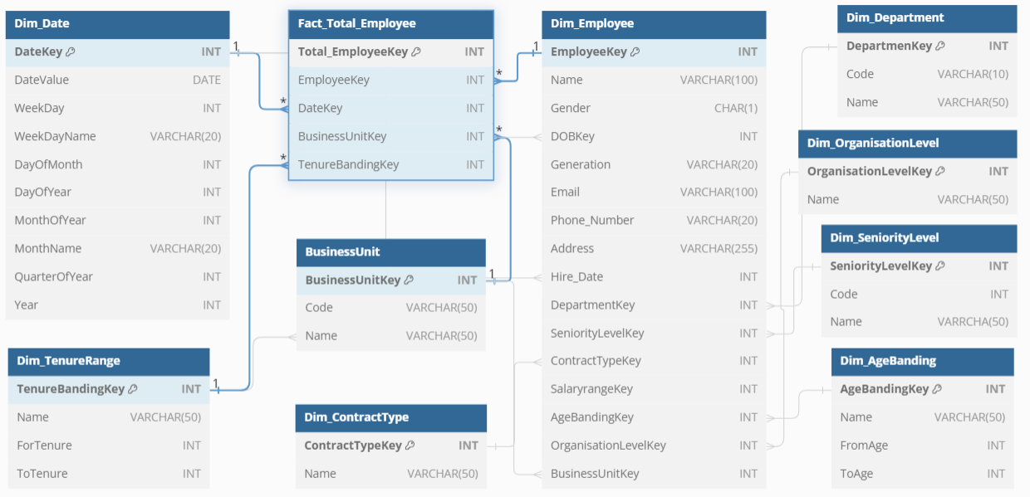
Database of Total Employee by Director

Slide 4
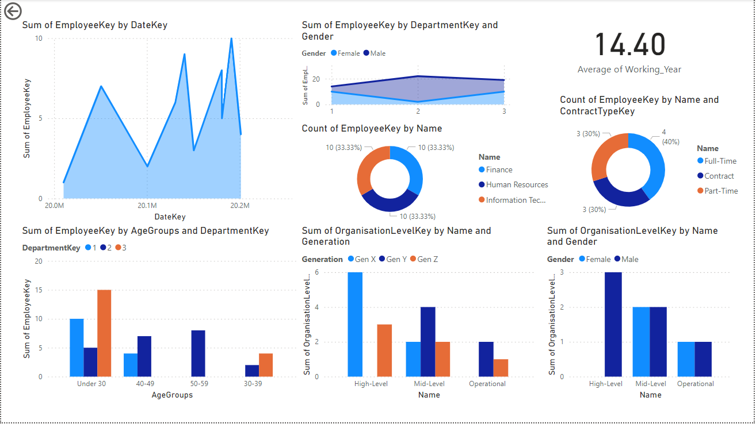
Dashboard for Total Employee

Slide 5

THANKS YOU FOR WATCHING

